Slide 1

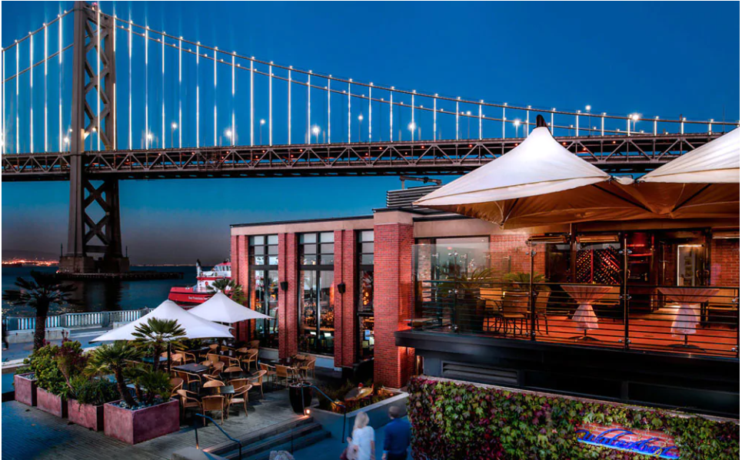
Buying a Bar in San Francisco
Santiago Falconi

Slide 2
Data Acquisition and Cleaning
San Francisco Police Department Incident Reports with over 354,000 of data. I cleaned up 1o unnecessary categories before analyzing the data.
Registered Business Locations in San Francisco with over 258,000 rows of data. The only relevant data is about location of registered businesses.

Slide 3
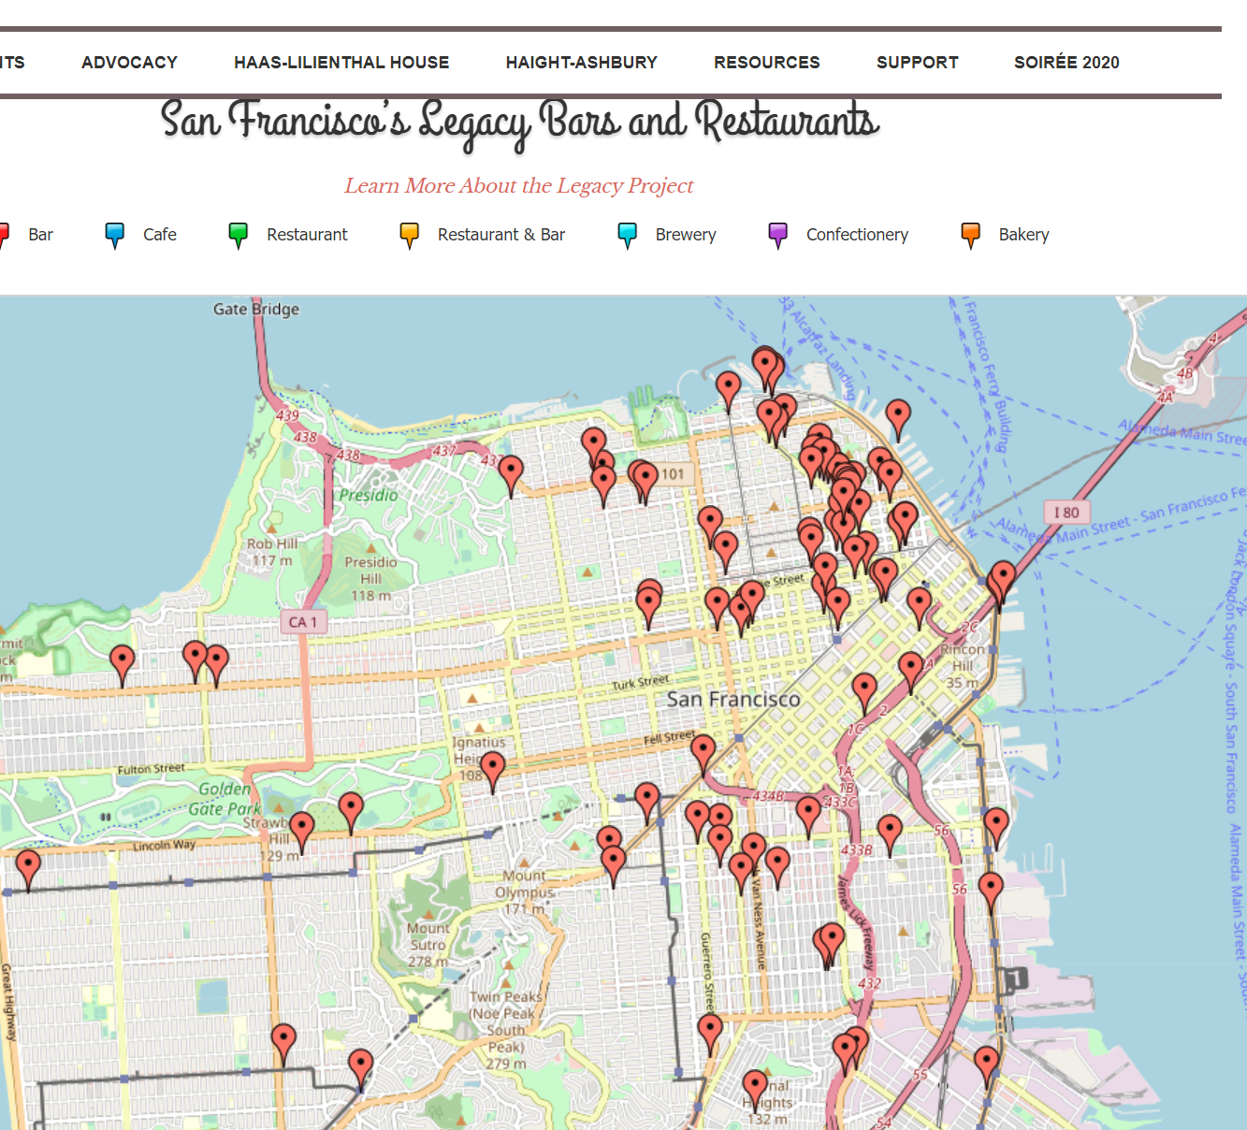
Location of Bars and Restaurants in San Francisco.
Marina/Cow Hollow
Mission District
Haight-Ashbury
The Tenderloin
Downtown
North Beach
Russian Hill
The Castro
SoMa

Slide 4
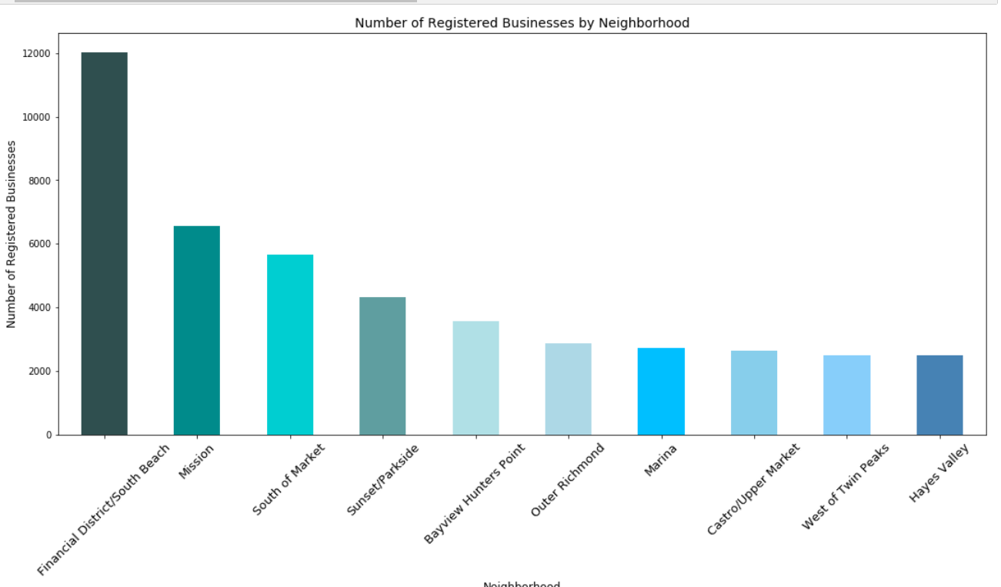
Number of Registered Businesses by Neighborhood
Financial District/South Beach has the greatest number of registered businesses among all the neighborhoods studied.
Because of the demand of locations for bars and restaurants, Financial Districts/South Beach has the highest price for leasing commercial spaces.

Slide 5
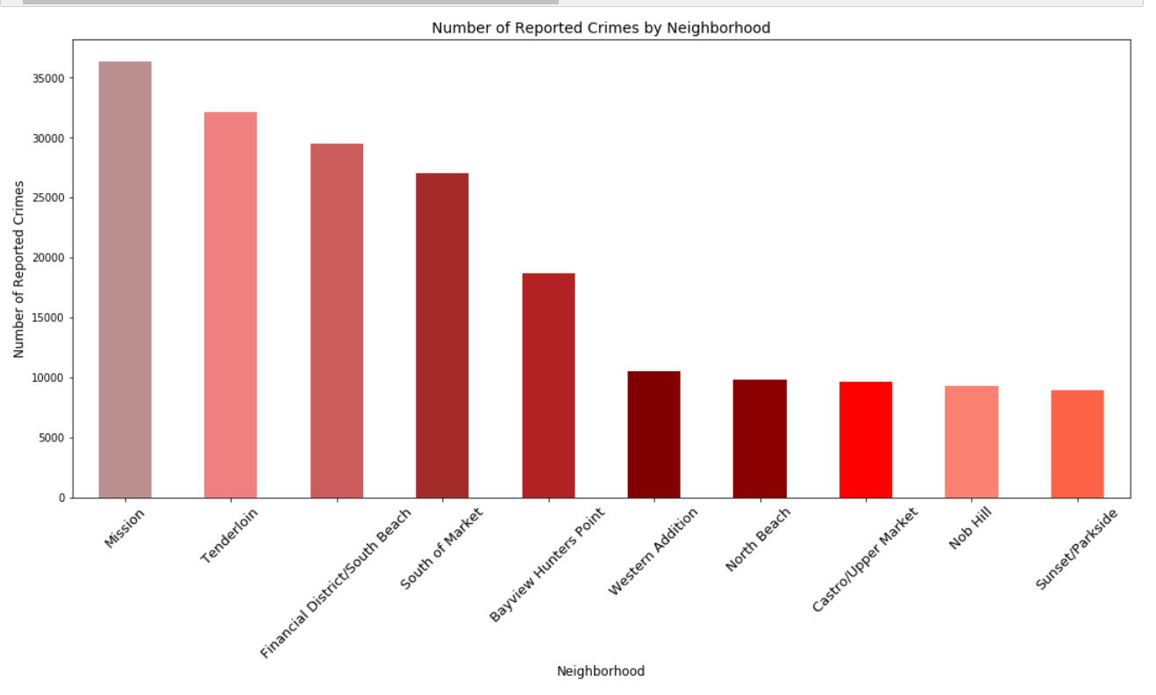
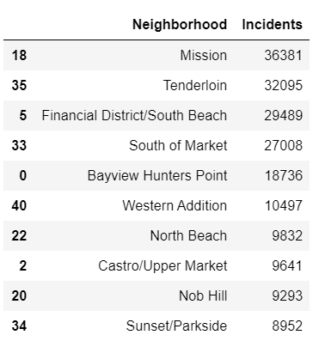
Number of Reported Crimes by Neighborhood
The data shows that Mission and Tenderloin are the least suitable neighborhoods to purchase a bar.

Slide 6
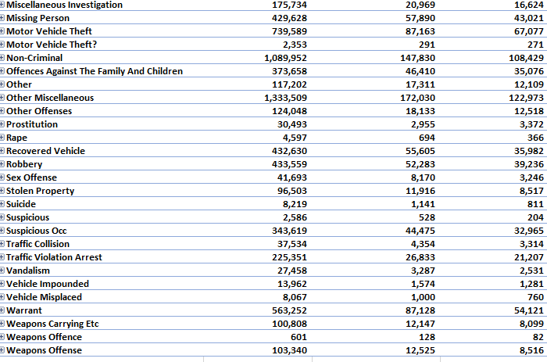
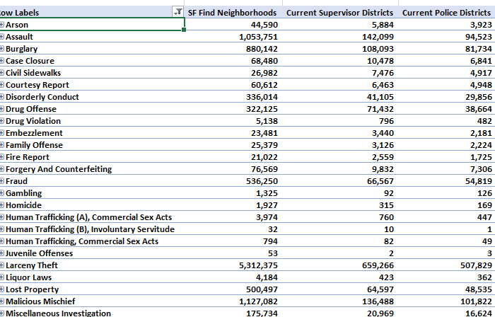
List of Registered Crimes by Category among Touristic Neighborhoods in San Francisco

Slide 7
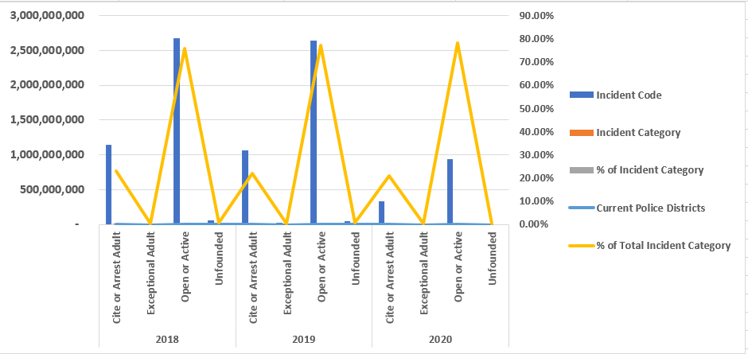
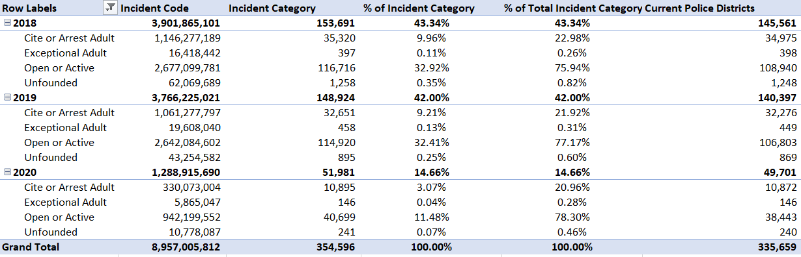
Breakdown of the Crimes by Category that Occurred at Prospecting Neighborhoods for Purchasing our Bar

Slide 8
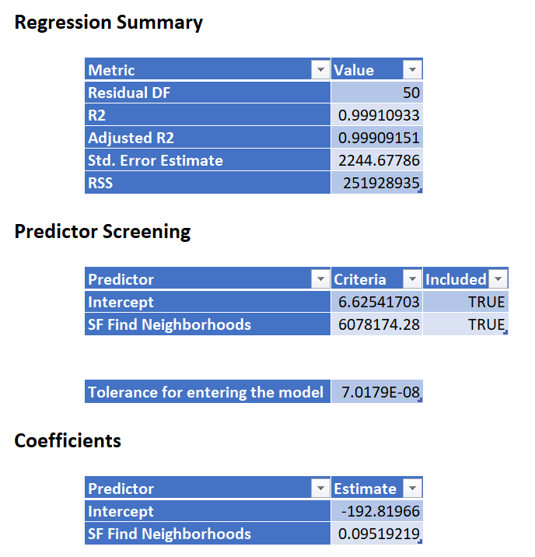
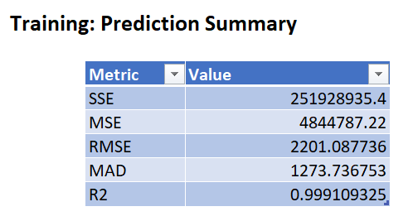
Linear Regression Model Summary

Slide 9
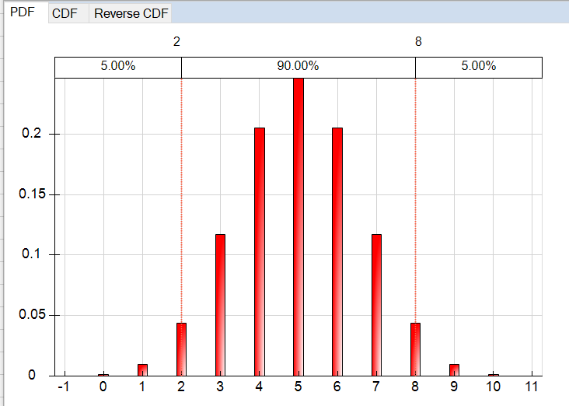
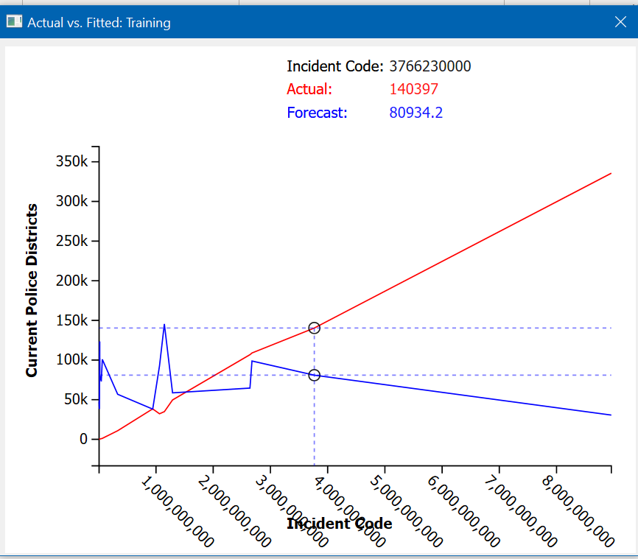
Binomial Distribution for the Linear Regression Model.
Comparison of Actual vs. Fitting demonstrate that our data from the Linear Regression Model is appropriate.

Slide 10
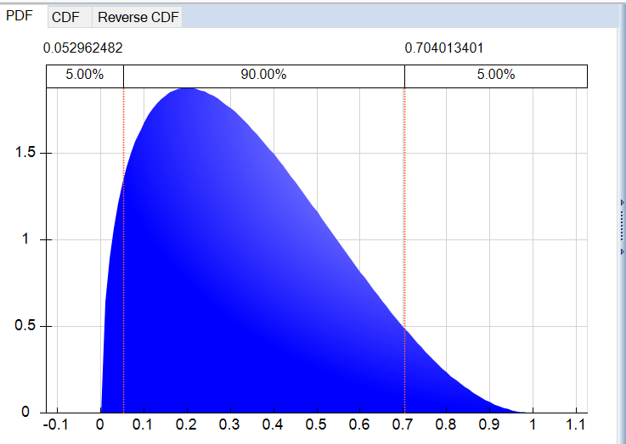
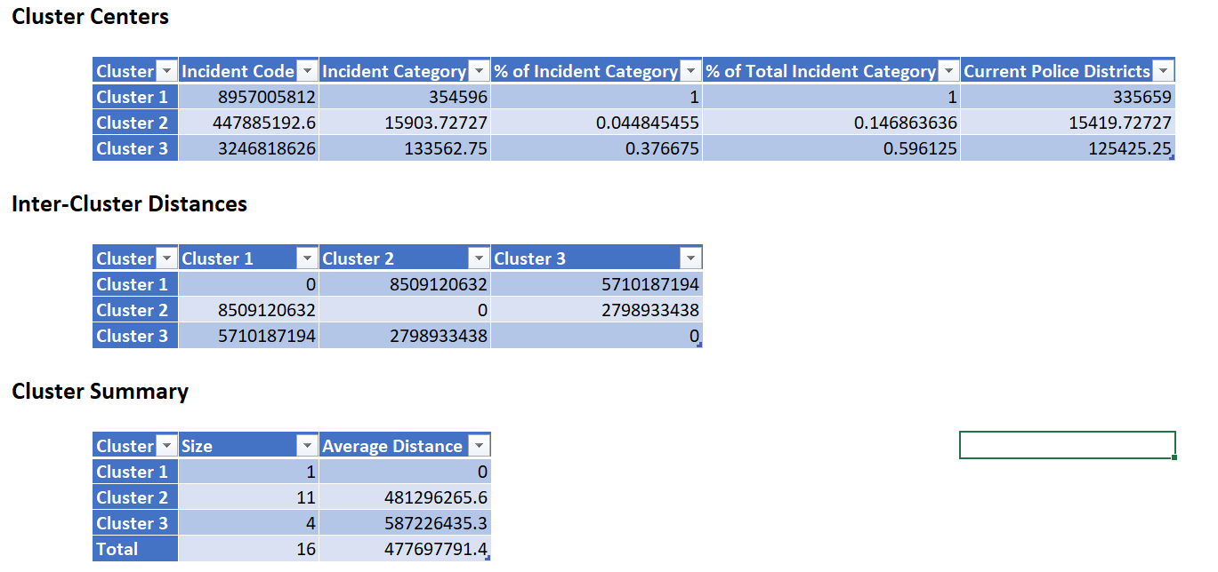
Normal Distribution Model with K-Means Clustering

Slide 11
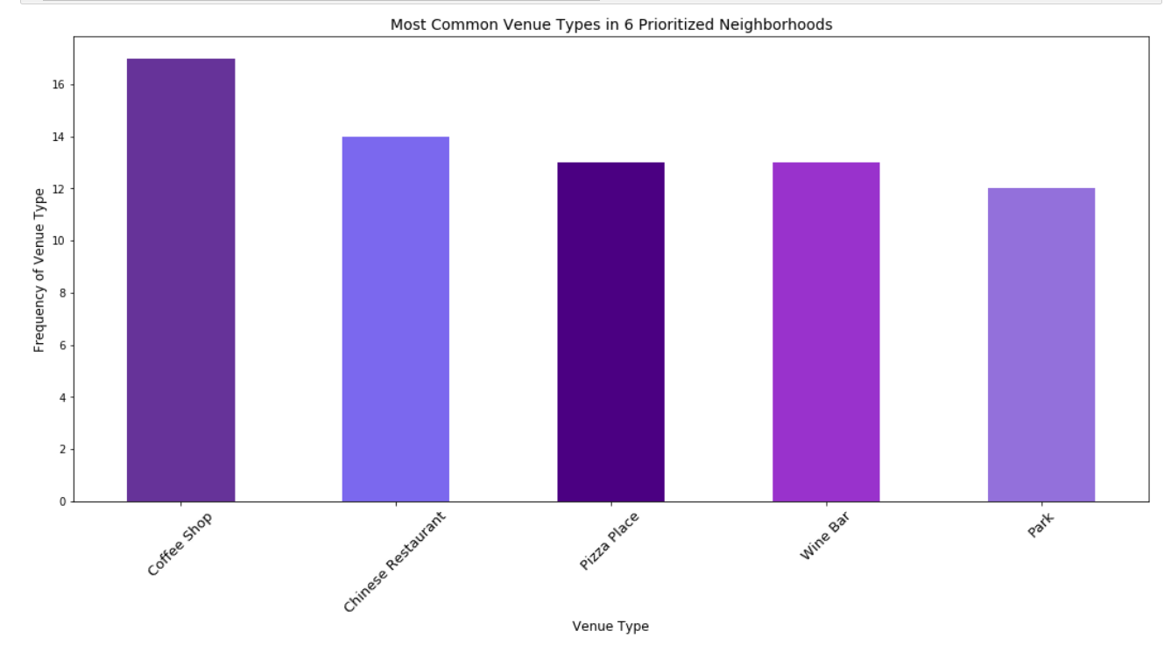
Most Common Venue Types in 6 Prioritized Neighborhoods
Venues that fall under the category of Coffee Shops are the most common businesses among the prioritized neighborhoods.

Slide 12
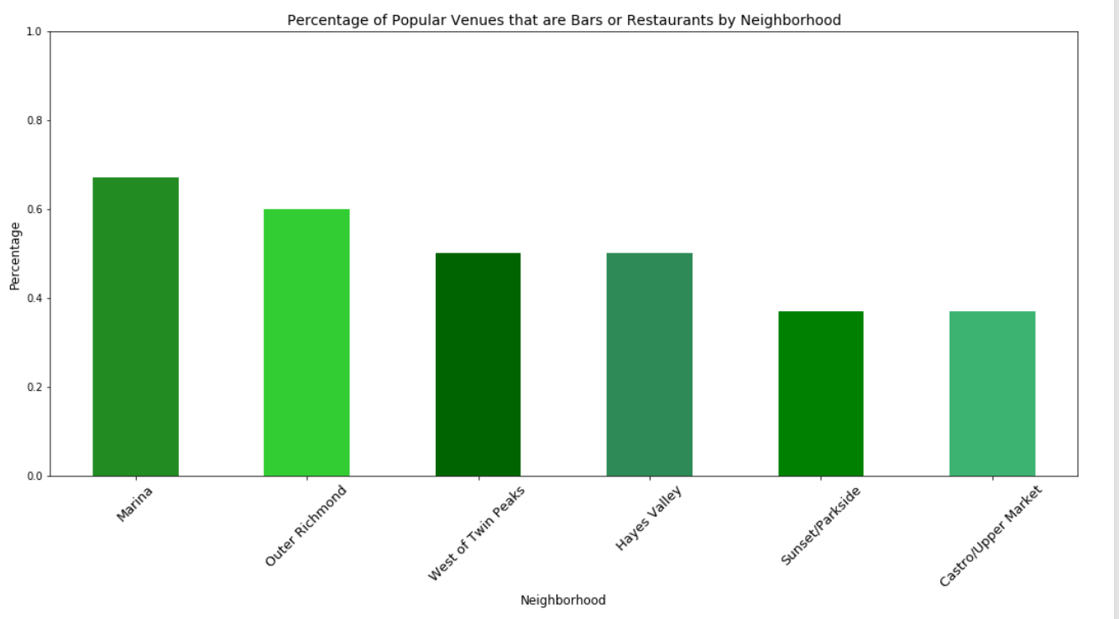
Percentages of Popular Venues that are Bars or Restaurants by Neighborhood
Marina and Outer Richmond have the highest percentages of popular bars and restaurants.
Most likely to select one of those two neighborhoods to purchase a bar.

Slide 13
Conclusion
Ultimately, the optimal bar spot depends on what type of bar you would like to open.
Coffee shops, Chinese Restaurants, Sandwich Shops, French restaurants, and Wine Bars are the most common venues in our 6 preferred neighborhoods.
Clustering neighborhoods based on their most popular venues grouped Hayes Valley with Castro into a cluster, West of Twin Peaks, Outer Richmond and Marina into another cluster, and Sunset as its own independent cluster.
Marina and Outer Richmond have majority bars and restaurants as popular venues, whereas most of the popular venues in Sunset and Castro are not bars or restaurants, but locations like parks and yoga studios.
From Zumper’s report in Figure 2, we know Marina, Castro, and Hayes Valley are more expensive places to live, with the median rent for a one-bedroom of at least $3,500.

